Slide 1
COMP 6321: Machine Learning
Face Recognition using Laplacian faces

Slide 2
Introduction
A common way to achieve face recognition is the appearance-based method.
Two of the most popular techniques are Principal Component Analysis (PCA) and Linear Discriminant Analysis (LDA).
PCA: PCA is an eigenvector method designed to model linear variation in high-dimensional data.
The main goal of PCA is to find a set of mutually orthogonal basis functions that capture the directions of maximum variance in the data and for which the coefficients are pairwise decorrelated.

Slide 3
LDA: LDA is a supervised learning algorithm.
LDA is primarily used to reduce the number of features to a more manageable number before classification.
LDA searches for the project axes on which the data points of different classes are far from each other while requiring data points of the same class to be close to each other.
Both PCA and LDA effectively see only the Euclidean structure. They fail to discover the underlying structure, if the face images lie on a nonlinear submanifold hidden in the image space.

Slide 4
Laplacianfaces for face recognition
Laplacianfaces refer to an appearance-based approach to human face representation and recognition.
The approach uses Locality Preserving Projection(LPP) to learn a locality preserving subspace which seeks to capture the intrinsic geometry of the data and the local structure.
When the projection is obtained, each face image in the image space is mapped to the low-dimensional face subspace, which is characterized by a set of feature images, they are called Laplacianfaces.

Slide 5
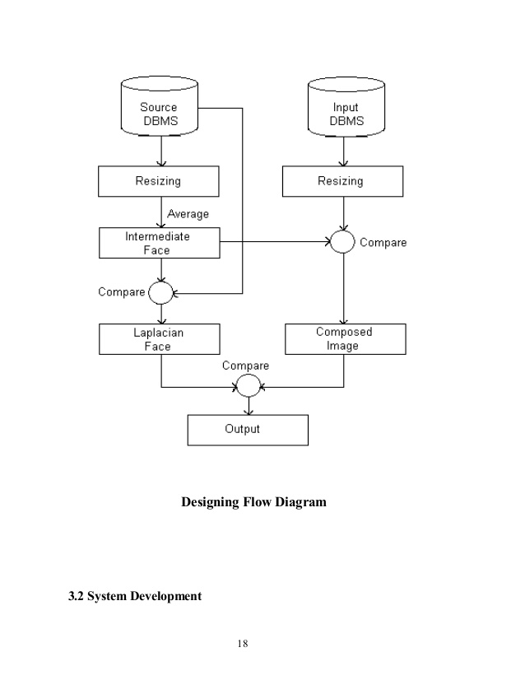
Flow Diagram

Slide 6
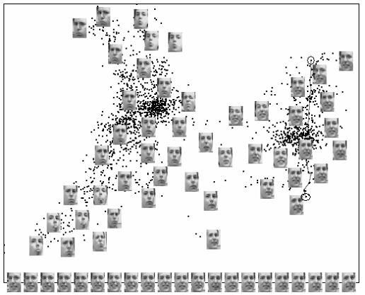

Slide 7
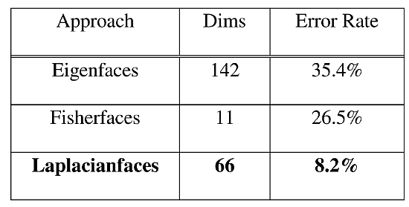
Error Rate of different face recognition methods.
The recognition results are shown below,
The recognition approaches the best results with 11, 66, 142 dimensions for Fisherfaces, Laplacianfaces, and Eigenfaces, respectively.

Slide 8
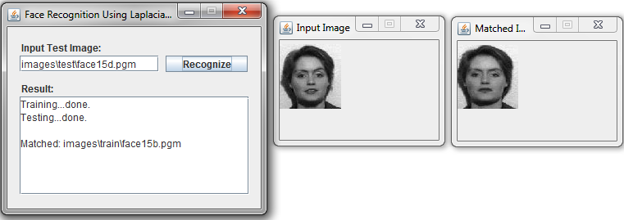
Implementation

Slide 9
Conclusion
Laplacian faces outperforms Eigen faces and Fischer faces approaches
It is a linear transform that optimally preserves the nonlinear local manifold structure.
Possible Extension of work
– Use of sophisticated and better distance metrics like variance normalized distance may improve the recognition performance
– The present work is that of face analysis. Possibly this can be extended to unlabelled classes.

Slide 10
References
http://people.cs.uchicago.edu/~niyogi/papersps/Laplacianface.pdf
https://en.wikipedia.org/wiki/LDA
https://en.wikipedia.org/wiki/Principal_component_analysis

Slide 11


